Slide 1

BETHANY YOUTH MEETING
FEBRUARY 2024

Slide 2

Songs
IT IS WELL WITH MY SOUL
WHAT A FRIEND WE HAVE IN JESUS
CAST YOUR BURDENS UNTO JESUS
ENDUKO NANNINTHAGA NEEVU
WAY MAKER, MIRACLE WORKER
DUNIYA KE IS SAFAR MEIN JAB REHTHA

Slide 3
IT IS WELL WITH MY SOUL
And the peace of God, which surpasses all understanding, will guard your hearts and your minds in Christ Jesus.
Philippians 4:7

Slide 4
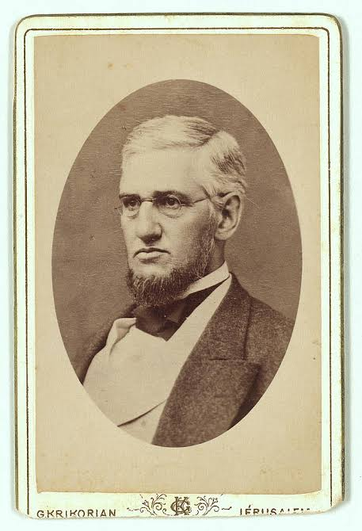
1871
Great Chicago Fire destroyed much of his real estate investments
1873
The SS Ville du Havre enroute to Europe with his wife and 4 children sank in the Atlantic Ocean. His wife Anna survived and sent a telegram to Horatio with the haunting words, "Saved alone."
As Horatio travelled to reunite with his grieving wife and as his ship passed near the spot where his daughters had died, Horatio found solace in his faith and wrote the lyrics to "It Is Well with My Soul."
Horatio G. Spafford

Slide 5
When peace like a river attendeth my way,
when sorrows like sea billows roll;
whatever my lot, thou hast taught me to say,
“It is well, it is well with my soul.”

Slide 6
It is well with my soul;
it is well, it is well with my soul.

Slide 7
Though Satan should buffet,
though trials should come,
Let this blest assurance control:
That Christ has regarded my helpless estate,
And has shed His own blood for my soul.

Slide 8
It is well with my soul;
it is well, it is well with my soul.

Slide 9
My sin oh, the bliss of this glorious thought!
My sin, not in part, but the whole,
Is nailed to the cross, and I bear it no more;
Praise the Lord, Praise the Lord, O my soul!

Slide 10
It is well with my soul;
it is well, it is well with my soul.

Slide 11
O Lord, haste the day when my faith shall be sight,
The clouds be rolled back as a scroll;
The trump shall resound and the Lord shall descend;
Even so, it is well with my soul.

Slide 12
It is well with my soul;
it is well, it is well with my soul.

Slide 13
WHAT A FRIEND WE HAVE IN JESUS
Do not be anxious about anything, but in every situation, by prayer and petition, with thanksgiving, present your requests to God.
Philippians 4:6

Slide 14
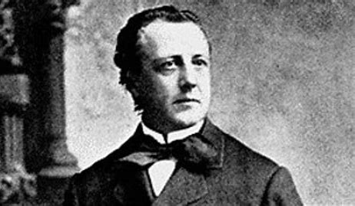
Experienced great loss with the sudden death of his fiancée on the eve of their wedding
Being away from his family in Ireland and received news that his mother was seriously ill, he wrote a poem titled "Pray Without Ceasing," to comfort her which came to be the words in this song
Joseph M. Scriven

Slide 15
What a Friend we have in Jesus,
All our sins and griefs to bear!
What a privilege to carry
Everything to God in prayer!
O what peace we often forfeit,
O what needless pain we bear,
All because we do not carry
Everything to God in prayer.

Slide 16
Have we trials and temptations?
Is there trouble anywhere?
We should never be discouraged;
Take it to the Lord in prayer.
Can we find a friend so faithful
Who will all our sorrows share?
Jesus knows our every weakness;
Take it to the Lord in prayer.

Slide 17
Paava sanja lathai neekka
Praana snegi dharunde
Paava baaram theerndhu poga
Meetpar paadham thanjame
Saala dhukka thunbathaale
Nenjam Nondhu sorungaal
Thumbam inbamaaga maarum
Ookamana jebathaal

Slide 18
Kashta nashta munda naalum
Yesu vandai seruvom
Mosa naasam nerittaalum
Jeba thoobam kaatuvom
Neekuvaare nenjin novai
Bela veenam thaanguvaar
Neekkuvaare manasorbai
Theeyagunam maatruvaar

Slide 19
CAST YOUR BURDENS UNTO JESUS
Cast your cares on the Lord and he will sustain you; he will never let the righteous be shaken.
Psalm 55:22

Slide 20
Cast your burdens unto Jesus,
for He cares for you.
Cast your burdens unto Jesus,
for He cares for you.

Slide 21
Higher higher,
higher higher higher
higher, higher
Lift Jesus higher.-----(2)

Slide 22
Lower lower,
lower lower lower
lower, lower
Stamp Satan lower.—--(2)

Slide 23
Cast your burdens unto Jesus,
for He cares for you.
Cast your burdens unto Jesus,
for He cares for you.

Slide 24
Higher higher,
higher higher higher
higher, higher
Lift Jesus higher.-----(2)

Slide 25
Lower lower,
lower lower lower
lower, lower
Stamp Satan lower.—--(2)

Slide 26
Cast your burdens unto Jesus,
for He cares for you.
Cast your burdens unto Jesus,
for He cares for you.

Slide 27
ENDUKO NANNINTHAGA NEEVU
For God so loved the world that he gave his one and only Son, that whoever believes in him shall not perish but have eternal life.
John 3:16

Slide 28
Enduko nanninthagaa neevu
Preminchithivo devaa
Anduko naa deena stuthi paathra
Hallelooya yesayyaa (2)

Slide 29
Naa paapamu baapa nara roopivainaavu
Naa shaapamu maapa naligi vrelaadithivi
Naaku chaalina devudavu neeve
Naa sthaanamulo neeve (2)

Slide 30
Enduko nanninthagaa neevu
Preminchithivo devaa
Anduko naa deena stuthi paathra
Hallelooya yesayyaa (2)

Slide 31
Nee roopamu naalo nirminchiyunnaavu
Nee polikalone nivasinchumannaavu
Neevu nannu ennukontivi
Nee korakaki nee krupalo (2)

Slide 32
Enduko nanninthagaa neevu
Preminchithivo devaa
Anduko naa deena stuthi paathra
Hallelooya yesayyaa (2)

Slide 33
Naa manavulu munde nee manasulo neravere
Naa manugada munde nee granthamulonunde
Emi adbhutha prema sankalpam
Nenemi chellinthun (2)

Slide 34
Enduko nanninthagaa neevu
Preminchithivo devaa
Anduko naa deena stuthi paathra
Hallelooya yesayyaa (2)

Slide 35
WAY MAKER, MIRACLE WORKER
You are the God who performs miracles; you display your power among the peoples.
Psalm 77:14

Slide 36
You are here, moving in our midst
I worship You, I worship You
You are here, working in this place
I worship You, I worship You

Slide 37
You are here, moving in our midst
I worship You, I worship You
You are here, working in this place
I worship You, I worship You

Slide 38
You are
Waymaker, miracle worker
Promise keeper, light in the darkness
My God, that is who You are

Slide 39
You are
Waymaker, miracle worker
Promise keeper, light in the darkness
My God, that is who You are

Slide 40
You are here, touching every heart
I worship You, I worship You
You are here, healing every heart
I worship You, I worship You

Slide 41
You are here, turning lives around
I worship You, I worship You
You are here, mending every heart
I worship You, I worship You

Slide 42
You are
Waymaker, miracle worker
Promise keeper, light in the darkness
My God, that is who You are

Slide 43
You are
Waymaker, miracle worker
Promise keeper, light in the darkness
My God, that is who You are

Slide 44
You are
Waymaker, miracle worker
Promise keeper, light in the darkness
My God, that is who You are
that is who You are
that is who You are
that is who You are

Slide 45
DUNIYA KE IS SAPHAR MEIN JAB RAHATA
….weeping may stay for the night, but rejoicing comes in the morning.
Psalm 30:5

Slide 46
Duniya ke is saphar mein jab rahata,
kabhee main rota, kabhee main hansata;
lekeen maseeh mere saath saath chalata ..
Duniya ke is saphar mein jab rahata (2)

Slide 47
Jeevan kee yaatra kitanee kathin hai, (2)
ghor andhakaar aur bhaaree tuphaan hai; (2)
pag pag mein thokar aata hee rahata, (2)
kaun hai sambhaale ? aur kaun hai bachata ? (2)

Slide 48
Duniya ke is saphar mein jab rahata,
kabhee main rota, kabhee main hansata;
lekeen maseeh mere saath saath chalata ..
Duniya ke is saphar mein jab rahata (2)

Slide 49
Antim samay tak saath bhee too deta, (2)
jab sab chhode, kabhee na too chhodata; (2)
hamesha uthaata aur naye bal se bharata, (2)
taaki main sthir rahoon yahee too chaahata. (2)

Slide 50
Duniya ke is saphar mein jab rahata,
kabhee main rota, kabhee main hansata;
lekeen maseeh mere saath saath chalata ..
Duniya ke is saphar mein jab rahata (2)

Slide 51
Testimony
Word
Kahoot Quiz

Slide 52
God Bless You
Bethany House of Worship

